Slide 1
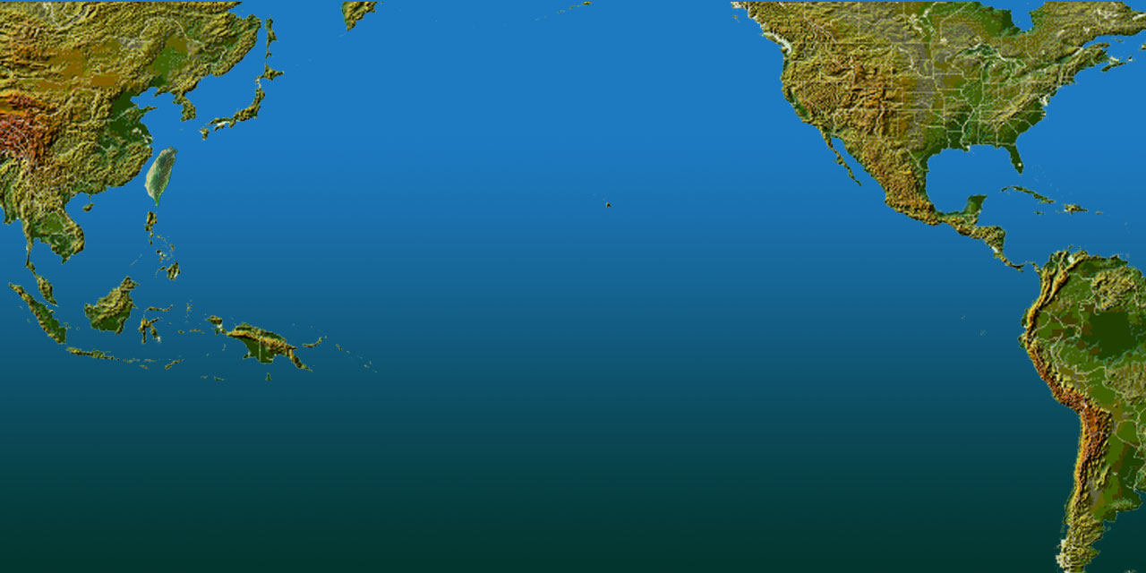
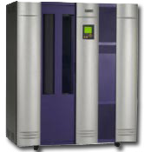
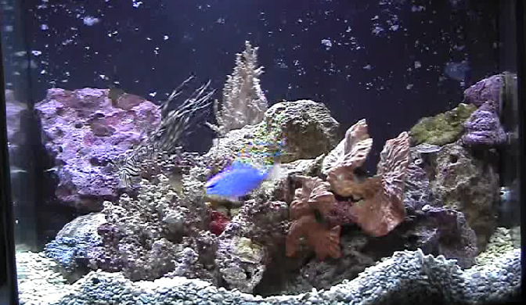
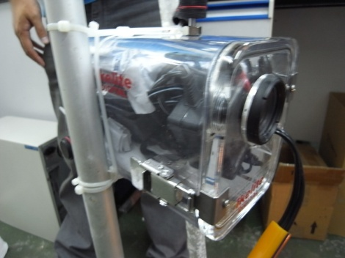
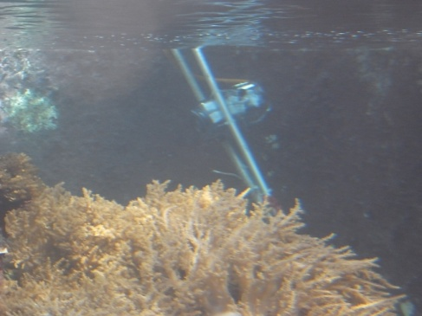
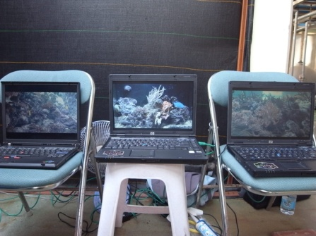
HD from Kenting @ SC08 NCHC, NMMBA, UCSD, TORI
UCSC, San Diego
OptIPuter
SC08, Austin (1G)
NCHC, Hsinchu
NMMBA, Kenting (2G)

